Slide 1
Earth System Models
Silvia Caldararu
Email: caldaras@tcd.ie

Slide 2
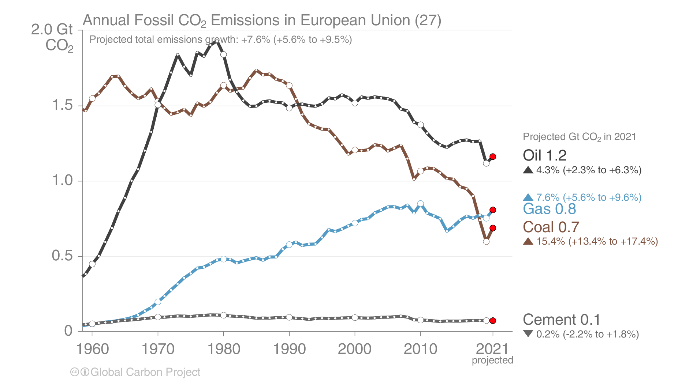
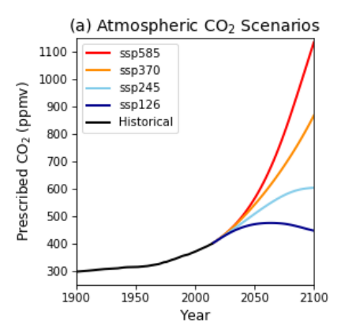
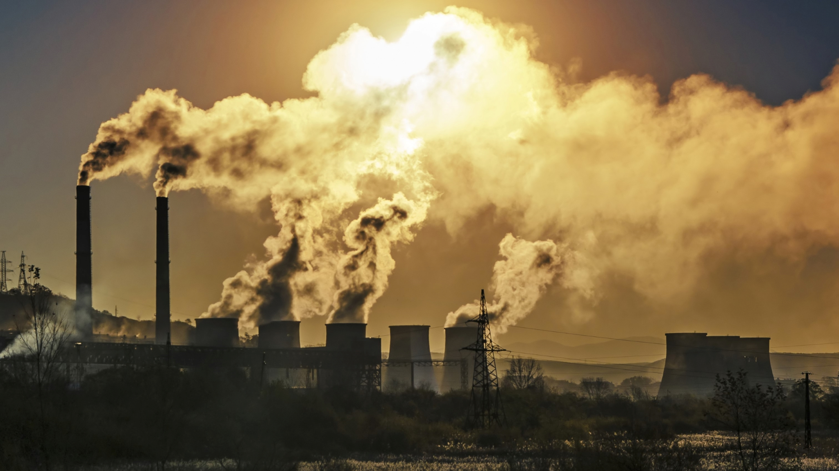
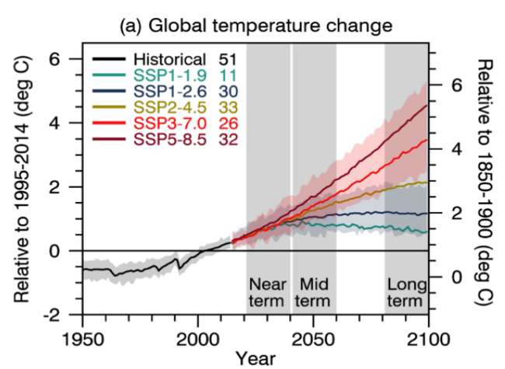
CO₂ emissions
How do we go from greenhouse gas emissions to prediction of future climate?
CO₂ concentrations
Changes in climate

Slide 3
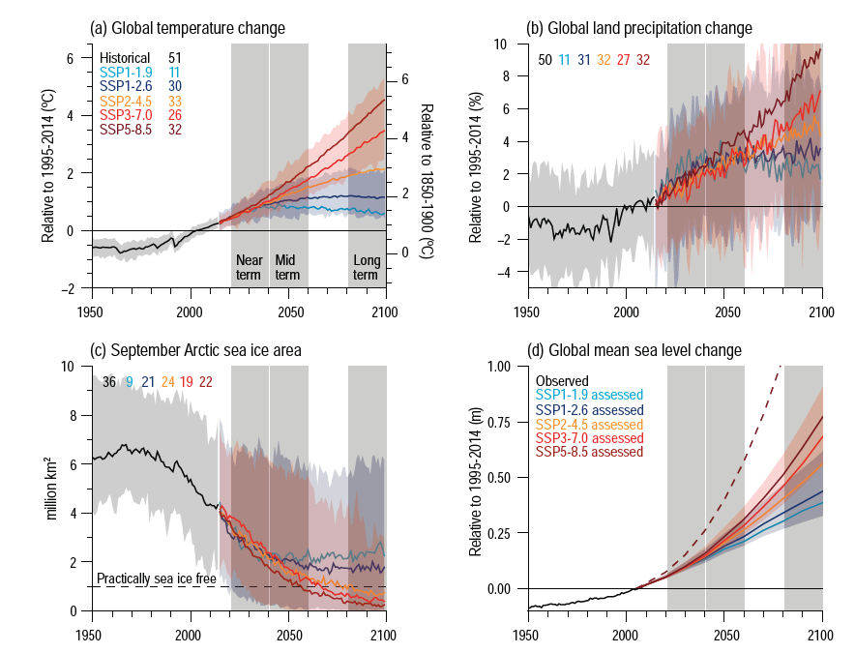
What are these predictions? What is uncertainty?

Slide 4
Earth system models

Slide 5
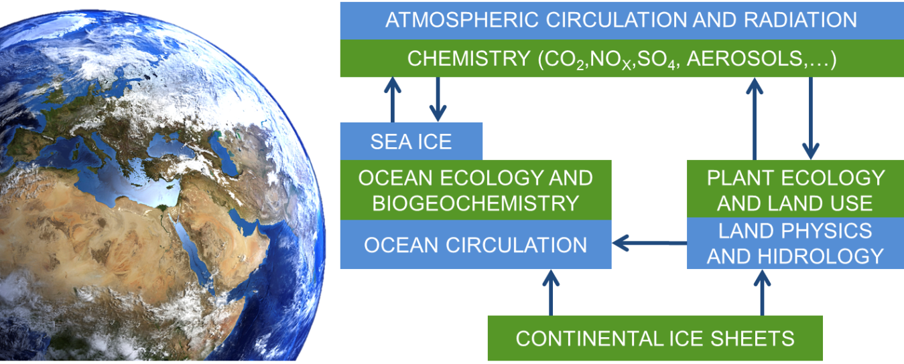
Earth system models - mathematical representations of our current knowledge of earth system processes

Slide 6
A short history of earth system models
1950s
Physics-driven atmospheric circulation models
Atmospheric-ocean coupling
The carbon cycle - biology on land and in the oceans
1990s
Human influence - land use change and emission scenarios
Present

Slide 7
Earth system models are not one thing - some definitions
General circulation model
Earth system model
Atmosphere
Ocean
Atmosphere
Ocean
Land surface
Sea ice
Models of the different components
Atmosphere
Ocean
Land surface
Sea ice

Slide 8
General model structure
Emission scenarios and land use
Process representation
Atmosphere
Ocean
Initial conditions
Land surface
Sea ice
Model predictions
Model parameters

Slide 9
A model is a mathematical representation of how we think the real world works
A model of how long it takes to get to college
T_{arrival} = T_{departure} + t_{walk to station} + t_{on the train} + t_{walk to department}
Process representation - equation

Slide 10
A model is a mathematical representation of how we think the real world works
A model of how long it takes to get to college
T_{arrival} = T_{departure} + t_{walk to station} + t_{on the train} + t_{walk to department}
Initial conditions
Prediction

Slide 11
A model is a mathematical representation of how we think the real world works
A model of how long it takes to get to college
T_{arrival} = T_{departure} + t_{walk to station} + t_{on the train} + t_{walk to department}
t_{walk to station} = 10 minutes
t_{on the train} = 35 minutes
t_{walk to department} = 5 minutes
Parameters

Slide 12
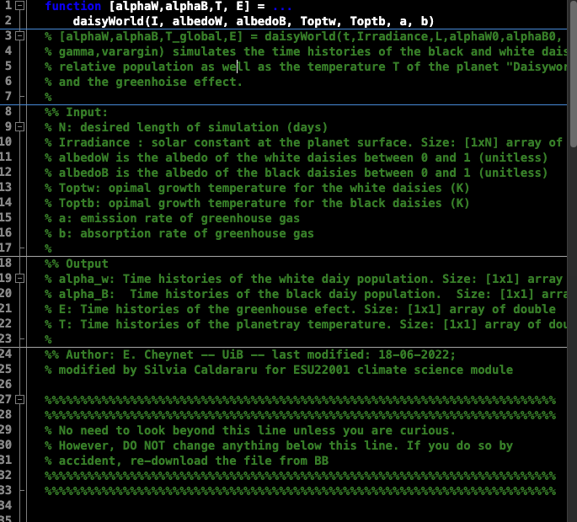
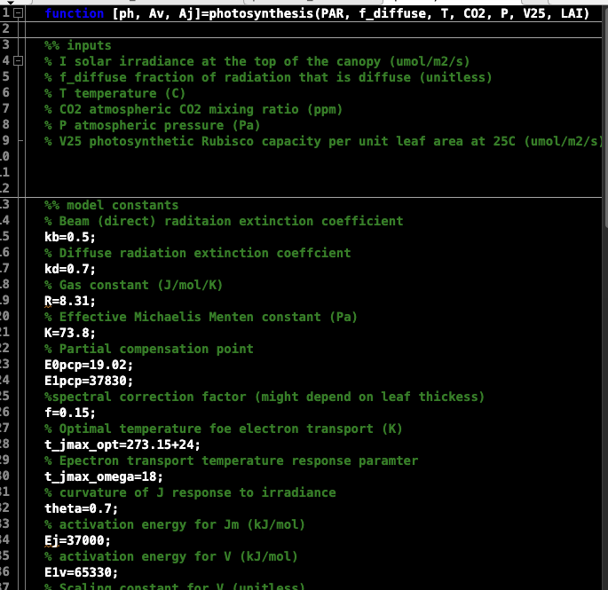
Simple models you have worked with
Daisyworld
Photosynthesis

Slide 13
General model structure
Emission scenarios and land use
Process representation
Atmosphere
Ocean
Initial conditions
Land surface
Sea ice
Model predictions
Model parameters

Slide 14
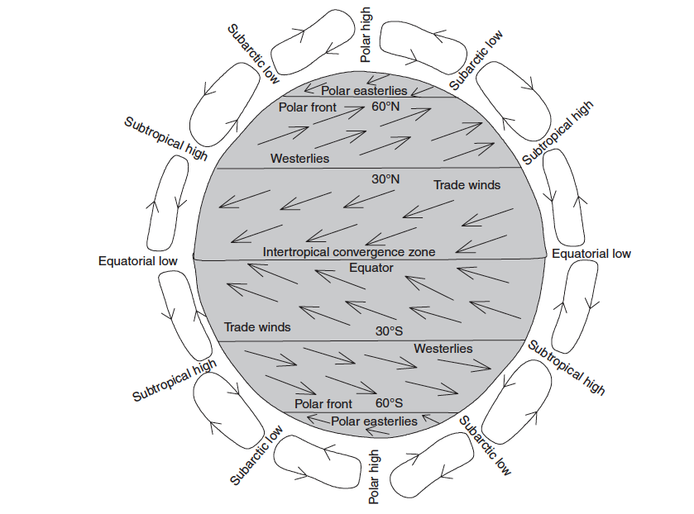
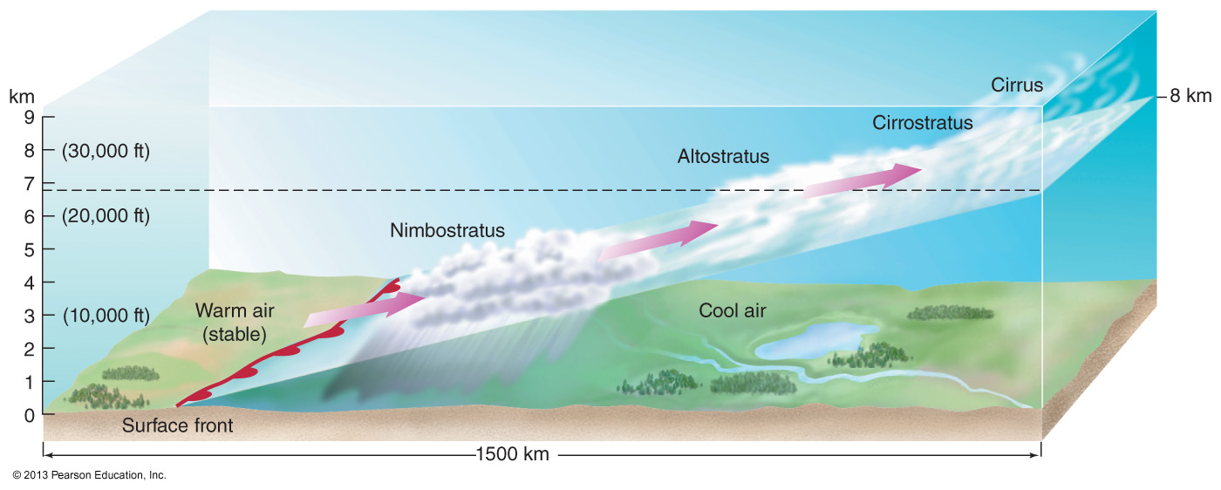
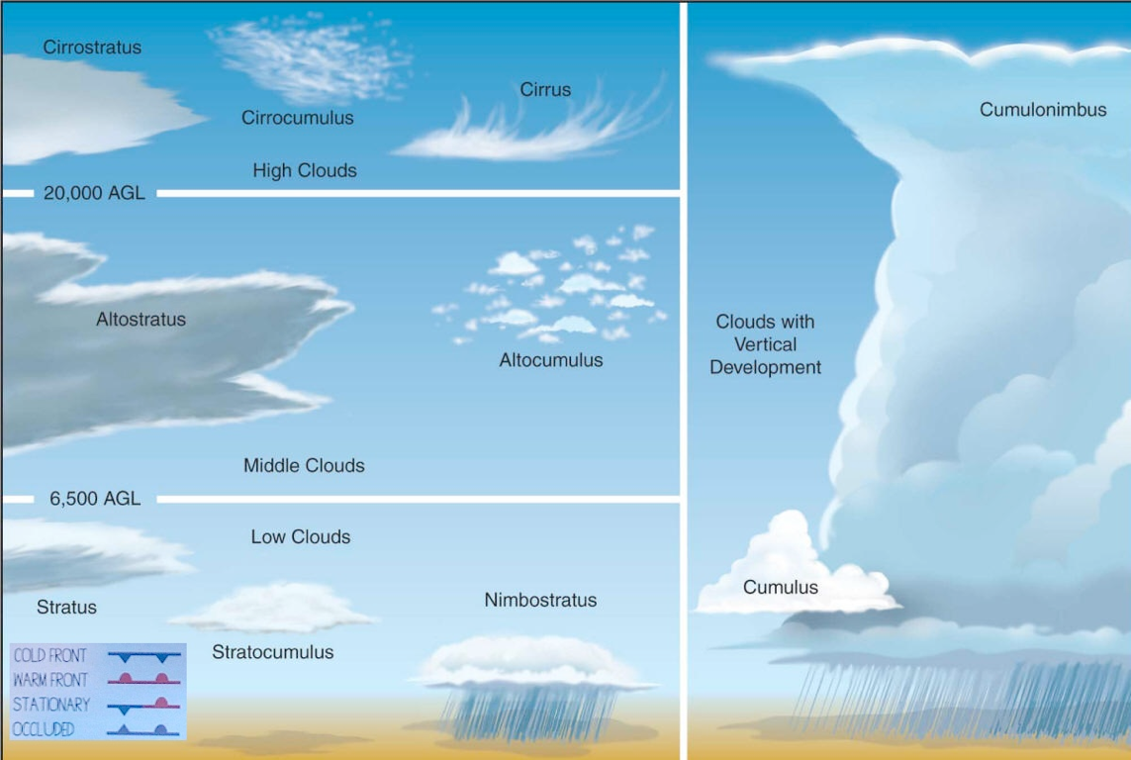
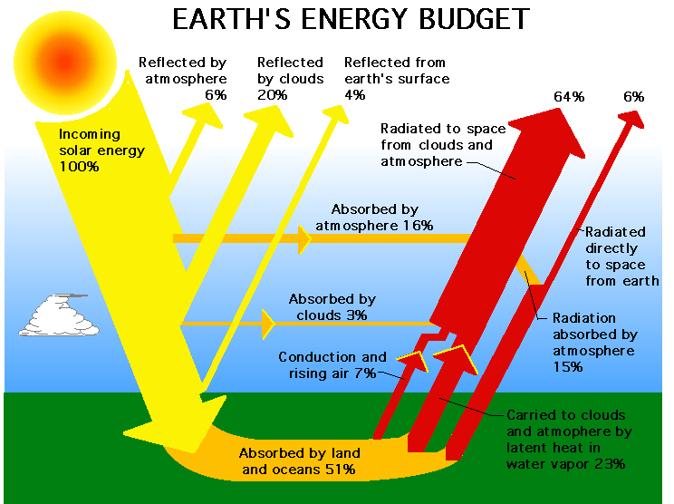
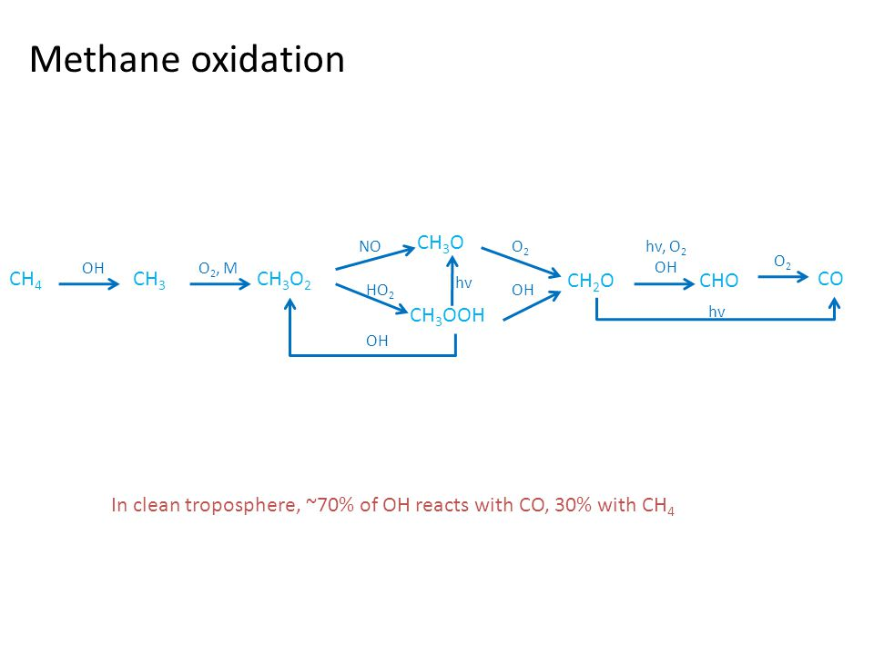
Process representation - atmosphere
Smaller-scale air movement
Global circulation
Cloud formation and precipitation
Energy budget
Atmospheric chemistry

Slide 15
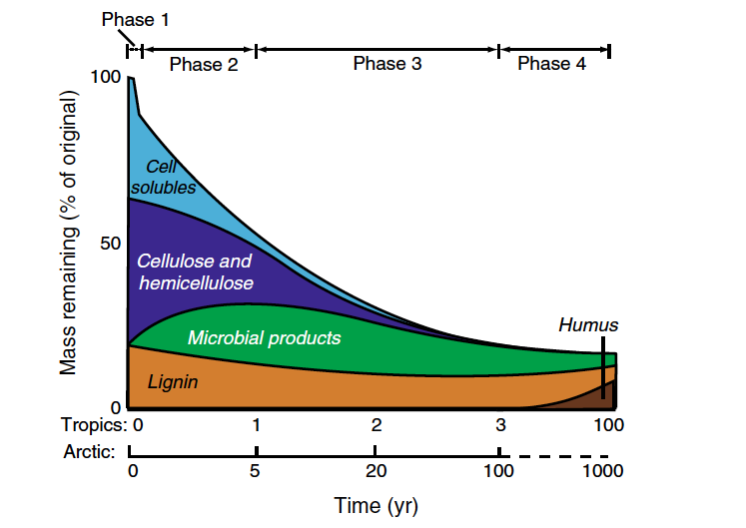
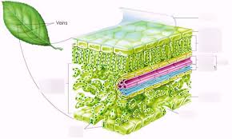
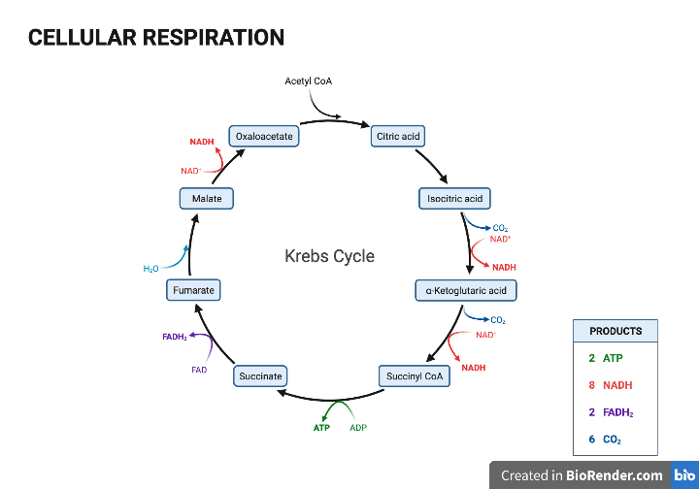
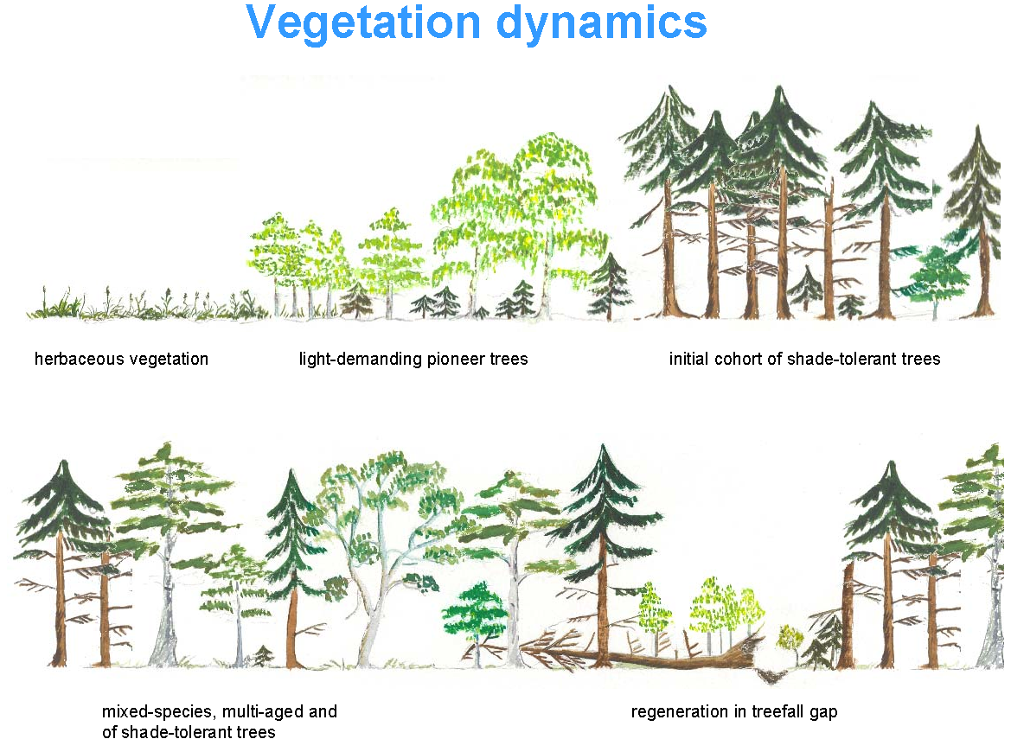
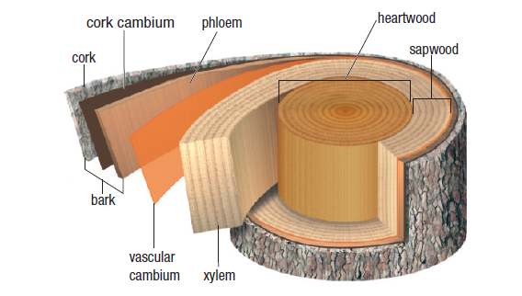
Process representation - land
Photosynthesis
Soil decomposition
Respiration
Plant growth
Vegetation dynamics

Slide 16
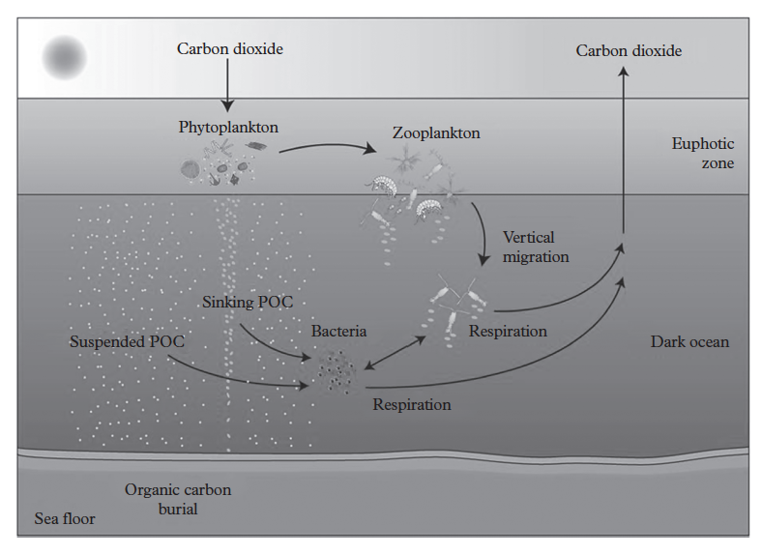
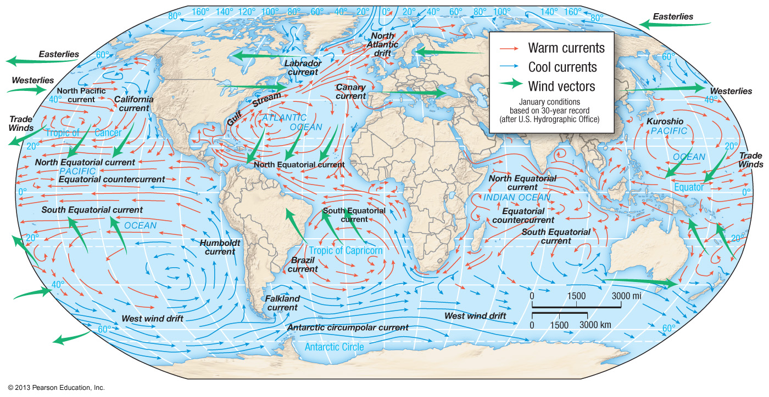
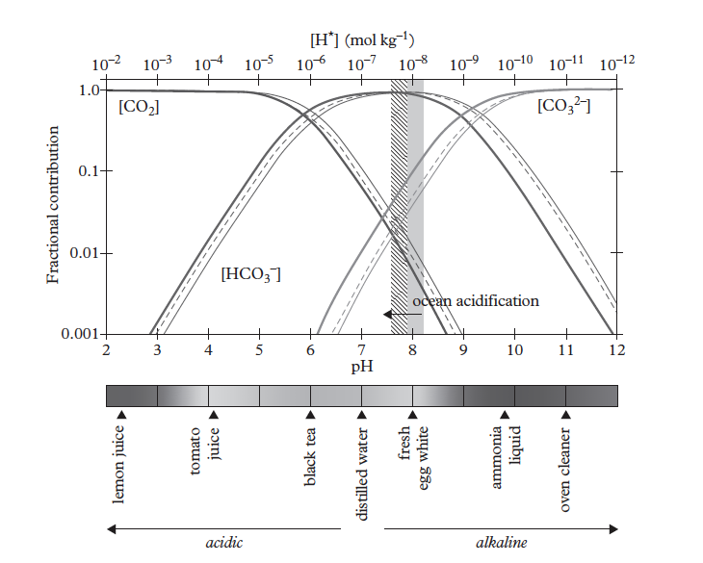
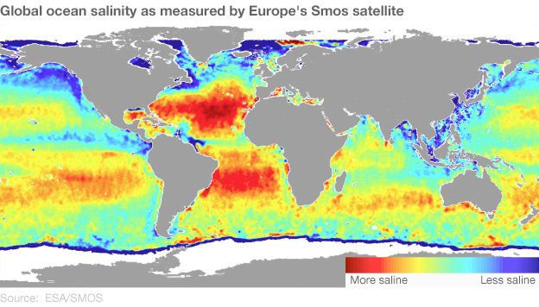
Process representation - ocean
Circulation
The biological carbon pump
Salinity and pH
The carbonate pump

Slide 17
Stand-alone land and ocean models
Climate variables as input:
Solar radiation, temperature, precipitation
Ocean
Land surface

Slide 18
Atmospheric coupling: climate variables calculated in model

Slide 19
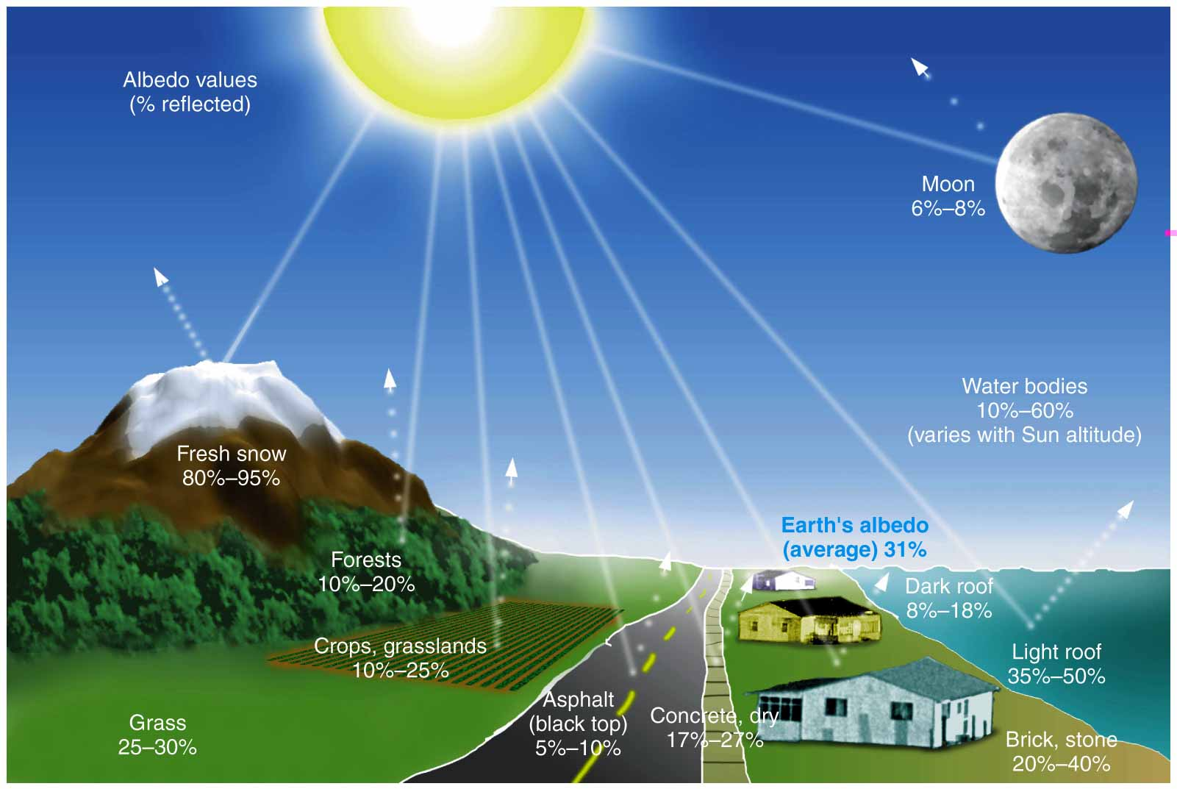
Land-atmosphere feedbacks: albedo
Land cover type affects albedo which affects the energy balance and temperature. Surface temperature affects circulation, moisture and precipitation patterns.

Slide 20
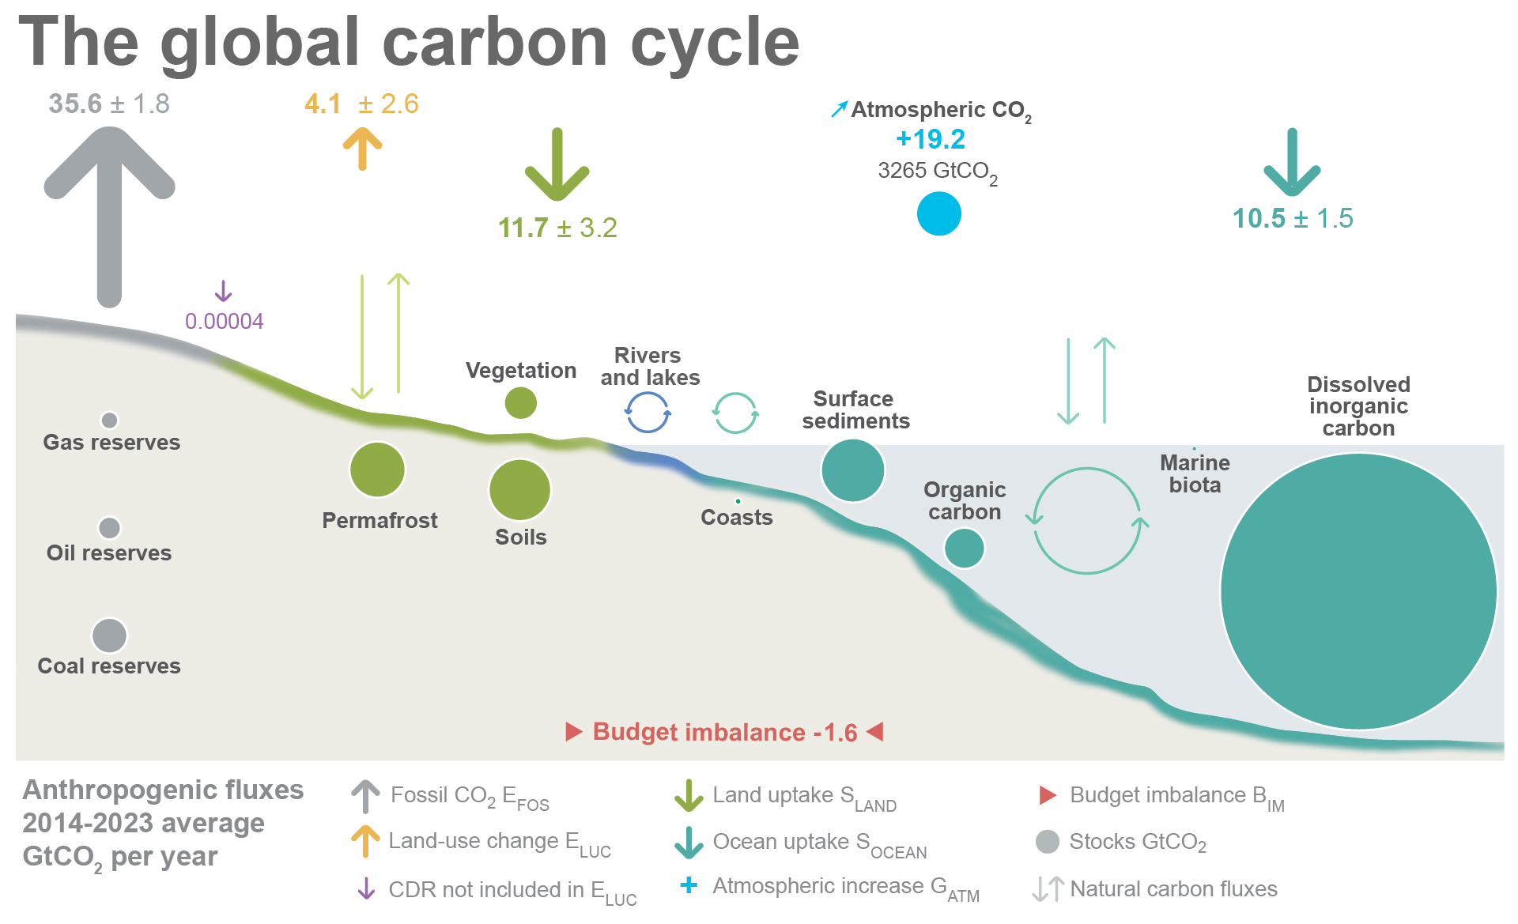
Land-atmosphere and ocean atmosphere feedbacks: CO₂ and temperature
CO₂ uptake affects atmospheric CO₂ concentrations which affect temperature. Temperature affects circulation, moisture and precipitation patterns. Temperature also affect the land and ocean capacity to take up CO₂.

Slide 21
The only inputs for a fully coupled Earth System Model is solar radiation at the top of the atmosphere, anthropogenic emissions and a land use map
Earth System Model
Atmosphere
Ocean
Land surface
Sea ice

Slide 22
A model is a mathematical representation of how we think the real world works
A model of how long it takes to get to college
T_{arrival} = T_{departure} + t_{walk to station} + t_{on the train} + t_{walk to department}
t_{walk to station} = 10 minutes
t_{on the train} = 35 minutes
t_{walk to department} = 5 minutes
Parameters

Slide 23
Parameters: physical constants
Gravitational constant
Molecular masses
Avogadro’s number
Ideal gas constant

Slide 24
Parameters: spatially variable properties
Soil texture
Albedo
Photosynthetic capacity
Plant type
Sea floor depth

Slide 25
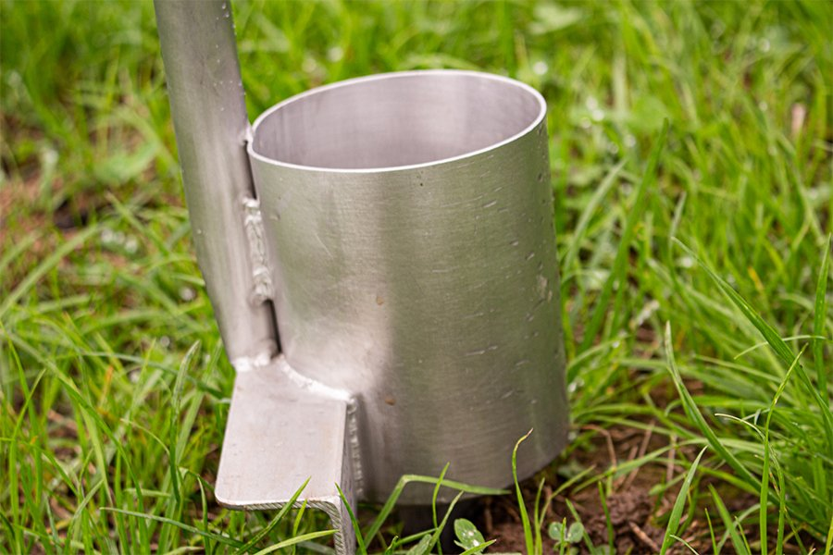
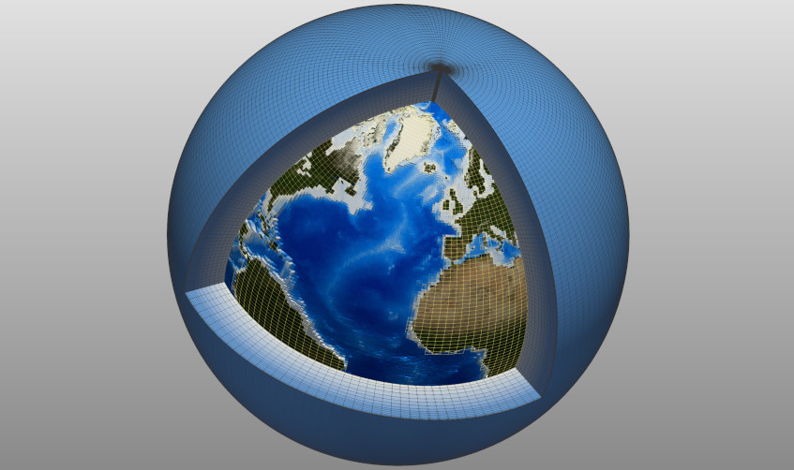
Parameter values from observations
Small scale observations

Slide 26
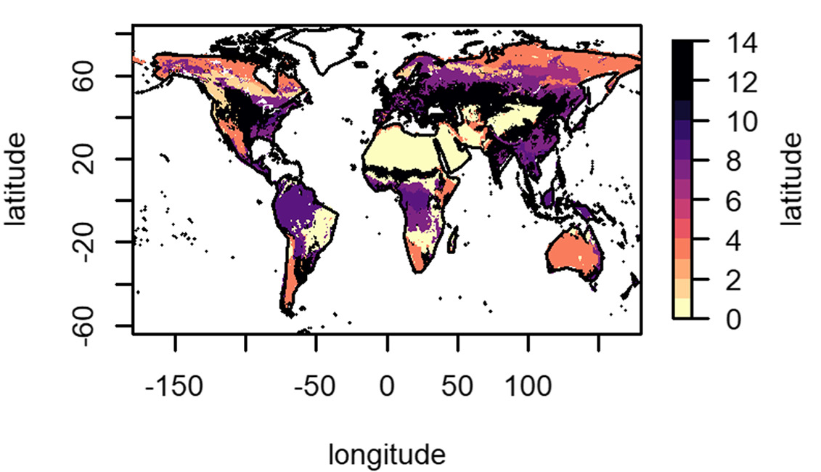
Parameter values from observations: paint by numbers
Scaling based on broad climate and ecosystem types
Small scale observations

Slide 27
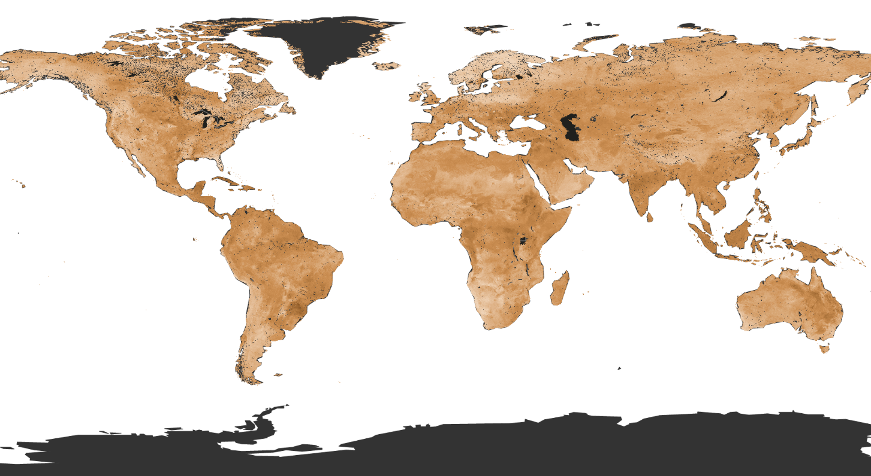
Parameter values from observations: machine learning
Scaling using machine learning methods
Small scale observations

Slide 28
General model structure
Emission scenarios and land use
Process representation
Atmosphere
Ocean
Initial conditions
Land surface
Sea ice
Model predictions
Model parameters

Slide 29

How does a model run in time?

Slide 30
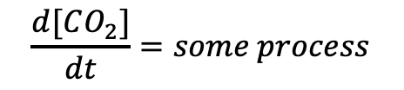
Differential versus discrete solutions
$$\frac{d[CO_{2}]}{dt}=some process$$
$${[CO}_{2}]\left(t\right)=\left[{CO}_{2}\right]\left(t−1\right)+some process$$
Differential equations can provide the solution at any point in time t
Useful for simple equations
Discrete solutions provide values at any point in time t dependent on the previous point at t-1
Used when the equations are too complex or there are too many of them

Slide 31
How does a model run in time?
Initial conditions
Air temperature at t=0
Sea temperature at t=0
CO₂ at t=0
…
…
Plankton biomass at t=0
Land biomass at t=0
Soil C at t=0
…
…
Air temperature at t=1
Sea temperature at t=1
CO₂ at t=1
…
…
Plankton biomass at t=1
Land biomass at t=1
Soil C at t=1
…
…
Final step
Air temperature at t=n
Sea temperature at t=n
CO₂ at t=n
…
…
Plankton biomass at t=n
Land biomass at t=n
Soil C at t=n
…
…
…
Model
processes

Slide 32
Model output: timeseries of many variables
Temporal resolution: what is the difference between model steps in time?

Slide 33
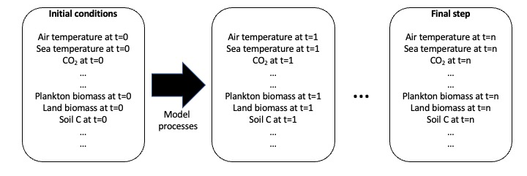
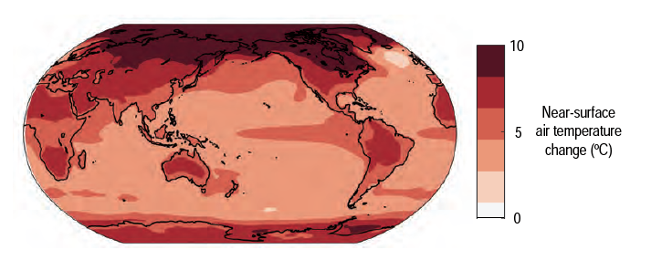
How does a model run in space?

Slide 34
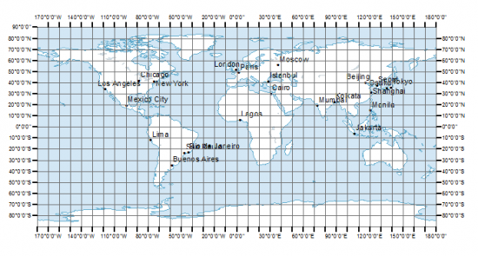
How does a model run in space?
Process calculations in every grid cell
Transport between cells when necessary

Slide 35
How does a model run in space?
Process calculations in every grid cell
Transport between cells when necessary
3D grids for the atmosphere and ocean

Slide 36
Trade offs between high and low resolution
Higher level of detail in high resolution simulations
More data needed in high resolution – not always available
Higher resolution needs more computer power and storage

Slide 37
Model output: timeseries of many variables in each grid cell
Spatial resolution: how big is a grid cell

Slide 38
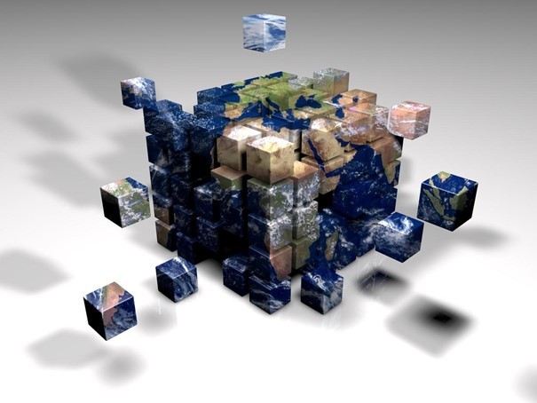
Model output: timeseries of many variables in each grid cell for many variables
Gridded, timeseries output available for atmospheric, ocean, land and cryosphere variables

Slide 39
General model structure
Emission scenarios and land use
Process representation
Atmosphere
Ocean
Initial conditions
Land surface
Sea ice
Model predictions
Model parameters

Slide 40
What are these predictions? What is uncertainty?

